Slide 1
Big Data Biogeography – Day 2
Alexander Zizka & Daniele Silvestro

Slide 2
Schedule for today
Morning
Lecture “Common biases, caveats and errors in biodiversity databases and tools to address them”
Fixing the Software setup
Discussion of student projects
Hands-on "Recent biodiversity patterns" in R (Obtaining occurrence records, data cleaning, exploring sampling bias)
Afternoon
Lecture “Novel tools for big data biogeography: bioregionalization, species to area classification, automated conservation assessment”
Hands-on: "Recent biogeography" (Species richness, taxon-specific bioregionalization, extracting environmental data)

Slide 3
Common biases, caveats and errors in biodiversity databases and tools to address them
Alexander Zizka & Daniele Silvestro

Slide 4

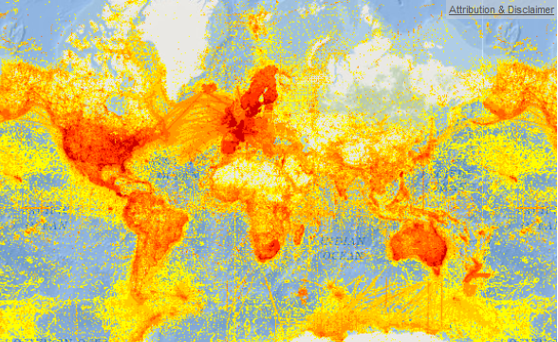



Species distribution data – a revolution
GBIF > 1 billion records
Notes:
1st data revolution
GBIF: > 760 million occurrence records

Slide 5
Fantastic!
How can we use these data in biogeography and ecology?

Slide 6
How can we use these data in biogeography and ecology?
Reproducibility
Data quality
Sampling bias

Slide 7
Reproducibility
FAIR data (Findable, Accessible, Interoperable, Reusable)
Reproducible pipelines
Scripting!

Slide 8
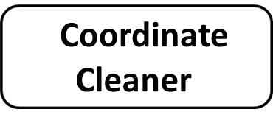
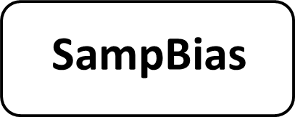




Analysis pipeline
1. Download
2. Cleaning
3. Bias
Rgbif
PaleobioDB
4. Species ranges & Richness maps
Bonus - Automated conservation assessment
6. Biome classification
5. Bioregionalization
ConR

Slide 9
Exercises
1. Downloading geographic occurrence data from GBIF (R)
2. Combine with data from the field & cleaning (R)
3. Quantifying sampling bias (R + GUI)
4. Species richness maps (R)
5. Bioregionaliation (GUI)
6. Biome classification (R)
7. Conservation assessment (R)

Slide 10

1. Download - Rgbif
Rgbif
A programmatic interface to the Web Service methods provided by the Global Biodiversity Information Facility
includes functions for searching for taxonomic names, retrieving information on data providers, getting species occurrence records, getting counts of occurrence records

Slide 11
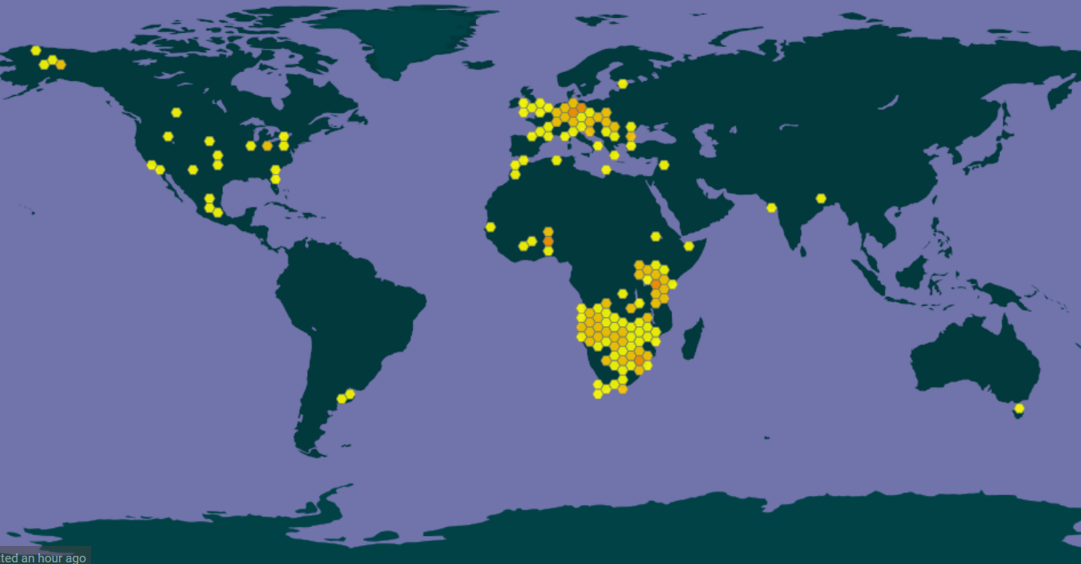
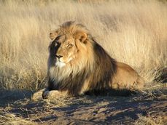
2. Data quality

Slide 12
2. Data cleaning - Common coordinate errors
Notes:
So lets start with the potentially problematic coordinates. There are a couple of common problems with coordinates from biological collection datasets, which arise from various sources, but mainly the fact that multiple people and multiple computers work on concstructing these datasets. And the problems occur both in expert curated datasets and in those from public aggregators such as GBIF and you have most likely encountered some of them yourself. So as an example imagine an dataset of occurrence records in South America, could be of a plant genus, that looks like this. Looks quite reasonable, but there a the most common problems hidden in here.
The first one are invalid coordinates, that is nonumeric entries or entries where the decimal point was replaced by a common etc, which you would not even see here
The second one are “zero coordinates” that us ciirdinates that have a plain zero, which is quite unlikely. That would be the three points highlighted here.
Then we have coordinates, that for some reason ended up in the sea, could be due to swaped longitude and latitude
Anotherthing that often happens is, that somewhere along the road, coordinates that just had a country information get coordinates assigned to the country centroids. (Which is fine for some analyses, but for others is fatal)
Similarly coordinates sometimes get assigned to the capital coordinates
Anotherthing tha can happen is that somehow the coordinates to not fit with a country information provided with the record
And a last common issue aer outliers, that occur for some reason. IN that case imagin a species that has a southern, Andean dsitribution like this, and out of a sudden there is one record there.
SO all these things you probably do not want to have in your analyses, but they are hard to find in larger datasets

Slide 13
2. Data cleaning - Common coordinate errors
Invalid or missing
Notes:
So lets start with the potentially problematic coordinates. There are a couple of common problems with coordinates from biological collection datasets, which arise from various sources, but mainly the fact that multiple people and multiple computers work on concstructing these datasets. And the problems occur both in expert curated datasets and in those from public aggregators such as GBIF and you have most likely encountered some of them yourself. So as an example imagine an dataset of occurrence records in South America, could be of a plant genus, that looks like this. Looks quite reasonable, but there a the most common problems hidden in here.
The first one are invalid coordinates, that is nonumeric entries or entries where the decimal point was replaced by a common etc, which you would not even see here
The second one are “zero coordinates” that us ciirdinates that have a plain zero, which is quite unlikely. That would be the three points highlighted here.
Then we have coordinates, that for some reason ended up in the sea, could be due to swaped longitude and latitude
Anotherthing that often happens is, that somewhere along the road, coordinates that just had a country information get coordinates assigned to the country centroids. (Which is fine for some analyses, but for others is fatal)
Similarly coordinates sometimes get assigned to the capital coordinates
Anotherthing tha can happen is that somehow the coordinates to not fit with a country information provided with the record
And a last common issue aer outliers, that occur for some reason. IN that case imagin a species that has a southern, Andean dsitribution like this, and out of a sudden there is one record there.
SO all these things you probably do not want to have in your analyses, but they are hard to find in larger datasets

Slide 14
2. Data cleaning - Common coordinate errors
Invalid or missing
Zeros
Notes:
So lets start with the potentially problematic coordinates. There are a couple of common problems with coordinates from biological collection datasets, which arise from various sources, but mainly the fact that multiple people and multiple computers work on concstructing these datasets. And the problems occur both in expert curated datasets and in those from public aggregators such as GBIF and you have most likely encountered some of them yourself. So as an example imagine an dataset of occurrence records in South America, could be of a plant genus, that looks like this. Looks quite reasonable, but there a the most common problems hidden in here.
The first one are invalid coordinates, that is nonumeric entries or entries where the decimal point was replaced by a common etc, which you would not even see here
The second one are “zero coordinates” that us ciirdinates that have a plain zero, which is quite unlikely. That would be the three points highlighted here.
Then we have coordinates, that for some reason ended up in the sea, could be due to swaped longitude and latitude
Anotherthing that often happens is, that somewhere along the road, coordinates that just had a country information get coordinates assigned to the country centroids. (Which is fine for some analyses, but for others is fatal)
Similarly coordinates sometimes get assigned to the capital coordinates
Anotherthing tha can happen is that somehow the coordinates to not fit with a country information provided with the record
And a last common issue aer outliers, that occur for some reason. IN that case imagin a species that has a southern, Andean dsitribution like this, and out of a sudden there is one record there.
SO all these things you probably do not want to have in your analyses, but they are hard to find in larger datasets

Slide 15
2. Data cleaning - Common coordinate errors
Invalid or missing
Zeros
Seas
Notes:
So lets start with the potentially problematic coordinates. There are a couple of common problems with coordinates from biological collection datasets, which arise from various sources, but mainly the fact that multiple people and multiple computers work on concstructing these datasets. And the problems occur both in expert curated datasets and in those from public aggregators such as GBIF and you have most likely encountered some of them yourself. So as an example imagine an dataset of occurrence records in South America, could be of a plant genus, that looks like this. Looks quite reasonable, but there a the most common problems hidden in here.
The first one are invalid coordinates, that is nonumeric entries or entries where the decimal point was replaced by a common etc, which you would not even see here
The second one are “zero coordinates” that us ciirdinates that have a plain zero, which is quite unlikely. That would be the three points highlighted here.
Then we have coordinates, that for some reason ended up in the sea, could be due to swaped longitude and latitude
Anotherthing that often happens is, that somewhere along the road, coordinates that just had a country information get coordinates assigned to the country centroids. (Which is fine for some analyses, but for others is fatal)
Similarly coordinates sometimes get assigned to the capital coordinates
Anotherthing tha can happen is that somehow the coordinates to not fit with a country information provided with the record
And a last common issue aer outliers, that occur for some reason. IN that case imagin a species that has a southern, Andean dsitribution like this, and out of a sudden there is one record there.
SO all these things you probably do not want to have in your analyses, but they are hard to find in larger datasets

Slide 16
2. Data cleaning - Common coordinate errors
Invalid or missing
Zeros
Seas
Country centroids
Notes:
So lets start with the potentially problematic coordinates. There are a couple of common problems with coordinates from biological collection datasets, which arise from various sources, but mainly the fact that multiple people and multiple computers work on concstructing these datasets. And the problems occur both in expert curated datasets and in those from public aggregators such as GBIF and you have most likely encountered some of them yourself. So as an example imagine an dataset of occurrence records in South America, could be of a plant genus, that looks like this. Looks quite reasonable, but there a the most common problems hidden in here.
The first one are invalid coordinates, that is nonumeric entries or entries where the decimal point was replaced by a common etc, which you would not even see here
The second one are “zero coordinates” that us ciirdinates that have a plain zero, which is quite unlikely. That would be the three points highlighted here.
Then we have coordinates, that for some reason ended up in the sea, could be due to swaped longitude and latitude
Anotherthing that often happens is, that somewhere along the road, coordinates that just had a country information get coordinates assigned to the country centroids. (Which is fine for some analyses, but for others is fatal)
Similarly coordinates sometimes get assigned to the capital coordinates
Anotherthing tha can happen is that somehow the coordinates to not fit with a country information provided with the record
And a last common issue aer outliers, that occur for some reason. IN that case imagin a species that has a southern, Andean dsitribution like this, and out of a sudden there is one record there.
SO all these things you probably do not want to have in your analyses, but they are hard to find in larger datasets

Slide 17
2. Data cleaning - Common coordinate errors
Invalid or missing
Zeros
Seas
Country centroids
Capitals
Notes:
So lets start with the potentially problematic coordinates. There are a couple of common problems with coordinates from biological collection datasets, which arise from various sources, but mainly the fact that multiple people and multiple computers work on concstructing these datasets. And the problems occur both in expert curated datasets and in those from public aggregators such as GBIF and you have most likely encountered some of them yourself. So as an example imagine an dataset of occurrence records in South America, could be of a plant genus, that looks like this. Looks quite reasonable, but there a the most common problems hidden in here.
The first one are invalid coordinates, that is nonumeric entries or entries where the decimal point was replaced by a common etc, which you would not even see here
The second one are “zero coordinates” that us ciirdinates that have a plain zero, which is quite unlikely. That would be the three points highlighted here.
Then we have coordinates, that for some reason ended up in the sea, could be due to swaped longitude and latitude
Anotherthing that often happens is, that somewhere along the road, coordinates that just had a country information get coordinates assigned to the country centroids. (Which is fine for some analyses, but for others is fatal)
Similarly coordinates sometimes get assigned to the capital coordinates
Anotherthing tha can happen is that somehow the coordinates to not fit with a country information provided with the record
And a last common issue aer outliers, that occur for some reason. IN that case imagin a species that has a southern, Andean dsitribution like this, and out of a sudden there is one record there.
SO all these things you probably do not want to have in your analyses, but they are hard to find in larger datasets

Slide 18
2. Data cleaning - Common coordinate errors
Invalid or missing
Zeros
Seas
Country centroids
Capitals
Institutions
Notes:
So lets start with the potentially problematic coordinates. There are a couple of common problems with coordinates from biological collection datasets, which arise from various sources, but mainly the fact that multiple people and multiple computers work on concstructing these datasets. And the problems occur both in expert curated datasets and in those from public aggregators such as GBIF and you have most likely encountered some of them yourself. So as an example imagine an dataset of occurrence records in South America, could be of a plant genus, that looks like this. Looks quite reasonable, but there a the most common problems hidden in here.
The first one are invalid coordinates, that is nonumeric entries or entries where the decimal point was replaced by a common etc, which you would not even see here
The second one are “zero coordinates” that us ciirdinates that have a plain zero, which is quite unlikely. That would be the three points highlighted here.
Then we have coordinates, that for some reason ended up in the sea, could be due to swaped longitude and latitude
Anotherthing that often happens is, that somewhere along the road, coordinates that just had a country information get coordinates assigned to the country centroids. (Which is fine for some analyses, but for others is fatal)
Similarly coordinates sometimes get assigned to the capital coordinates
Anotherthing tha can happen is that somehow the coordinates to not fit with a country information provided with the record
And a last common issue aer outliers, that occur for some reason. IN that case imagin a species that has a southern, Andean dsitribution like this, and out of a sudden there is one record there.
SO all these things you probably do not want to have in your analyses, but they are hard to find in larger datasets

Slide 19
2. Data cleaning - Common coordinate errors
Invalid or missing
Zeros
Seas
Country centroids
Capitals
Institutions
Wrong country
Argentina
Chile
Venezuela
Notes:
So lets start with the potentially problematic coordinates. There are a couple of common problems with coordinates from biological collection datasets, which arise from various sources, but mainly the fact that multiple people and multiple computers work on concstructing these datasets. And the problems occur both in expert curated datasets and in those from public aggregators such as GBIF and you have most likely encountered some of them yourself. So as an example imagine an dataset of occurrence records in South America, could be of a plant genus, that looks like this. Looks quite reasonable, but there a the most common problems hidden in here.
The first one are invalid coordinates, that is nonumeric entries or entries where the decimal point was replaced by a common etc, which you would not even see here
The second one are “zero coordinates” that us ciirdinates that have a plain zero, which is quite unlikely. That would be the three points highlighted here.
Then we have coordinates, that for some reason ended up in the sea, could be due to swaped longitude and latitude
Anotherthing that often happens is, that somewhere along the road, coordinates that just had a country information get coordinates assigned to the country centroids. (Which is fine for some analyses, but for others is fatal)
Similarly coordinates sometimes get assigned to the capital coordinates
Anotherthing tha can happen is that somehow the coordinates to not fit with a country information provided with the record
And a last common issue aer outliers, that occur for some reason. IN that case imagin a species that has a southern, Andean dsitribution like this, and out of a sudden there is one record there.
SO all these things you probably do not want to have in your analyses, but they are hard to find in larger datasets

Slide 20
2. Data cleaning - Common coordinate errors
Invalid or missing
Zeros
Seas
Country centroids
Capitals
Institutions
Wrong country
Outliers
Argentina
Chile
Venezuela
Notes:
So lets start with the potentially problematic coordinates. There are a couple of common problems with coordinates from biological collection datasets, which arise from various sources, but mainly the fact that multiple people and multiple computers work on concstructing these datasets. And the problems occur both in expert curated datasets and in those from public aggregators such as GBIF and you have most likely encountered some of them yourself. So as an example imagine an dataset of occurrence records in South America, could be of a plant genus, that looks like this. Looks quite reasonable, but there a the most common problems hidden in here.
The first one are invalid coordinates, that is nonumeric entries or entries where the decimal point was replaced by a common etc, which you would not even see here
The second one are “zero coordinates” that us ciirdinates that have a plain zero, which is quite unlikely. That would be the three points highlighted here.
Then we have coordinates, that for some reason ended up in the sea, could be due to swaped longitude and latitude
Anotherthing that often happens is, that somewhere along the road, coordinates that just had a country information get coordinates assigned to the country centroids. (Which is fine for some analyses, but for others is fatal)
Similarly coordinates sometimes get assigned to the capital coordinates
Anotherthing tha can happen is that somehow the coordinates to not fit with a country information provided with the record
And a last common issue aer outliers, that occur for some reason. IN that case imagin a species that has a southern, Andean dsitribution like this, and out of a sudden there is one record there.
SO all these things you probably do not want to have in your analyses, but they are hard to find in larger datasets

Slide 21
Analysis pipeline
1. Download
2. Cleaning
3. Bias
Rgbif
PaleobioDB
4. Richness maps
Bonus - Automated conservation assessment
6. Biome classification
5. Bioregionalization
ConR

Slide 22
2. Data cleaning - CoordinateCleaner
An R-package to identify potentially problematic records based on gazetteers
https://github.com/azizka/CoordinateCleaner

Slide 23
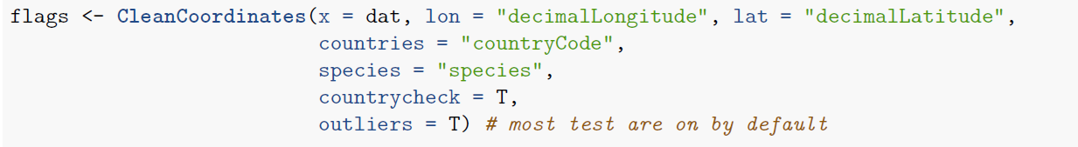
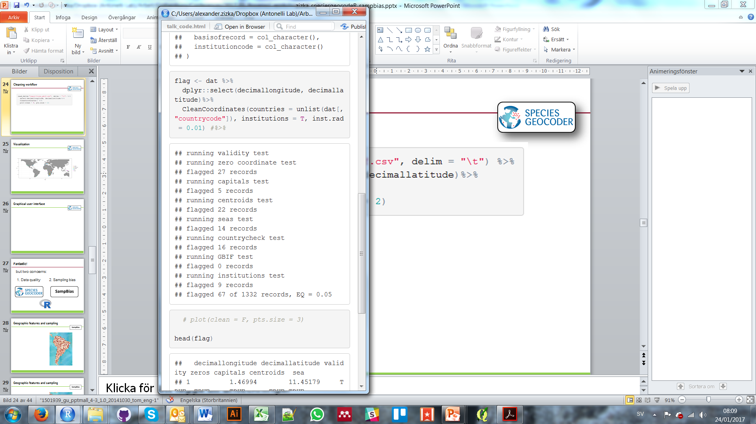
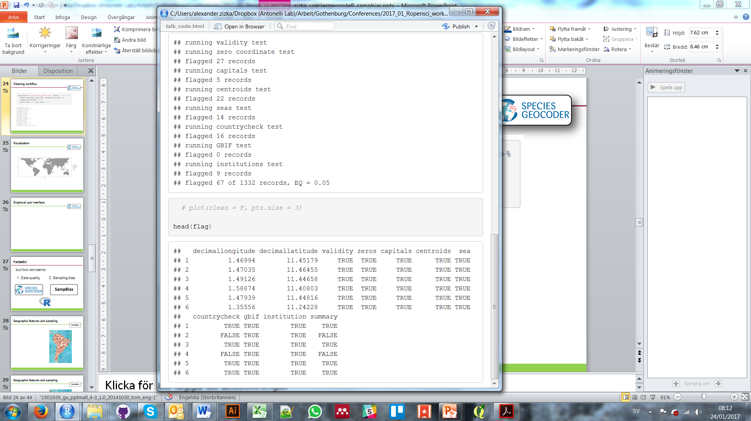
2. Data cleaning - Workflow
https://github.com/azizka/speciesgeocodeR

Slide 24
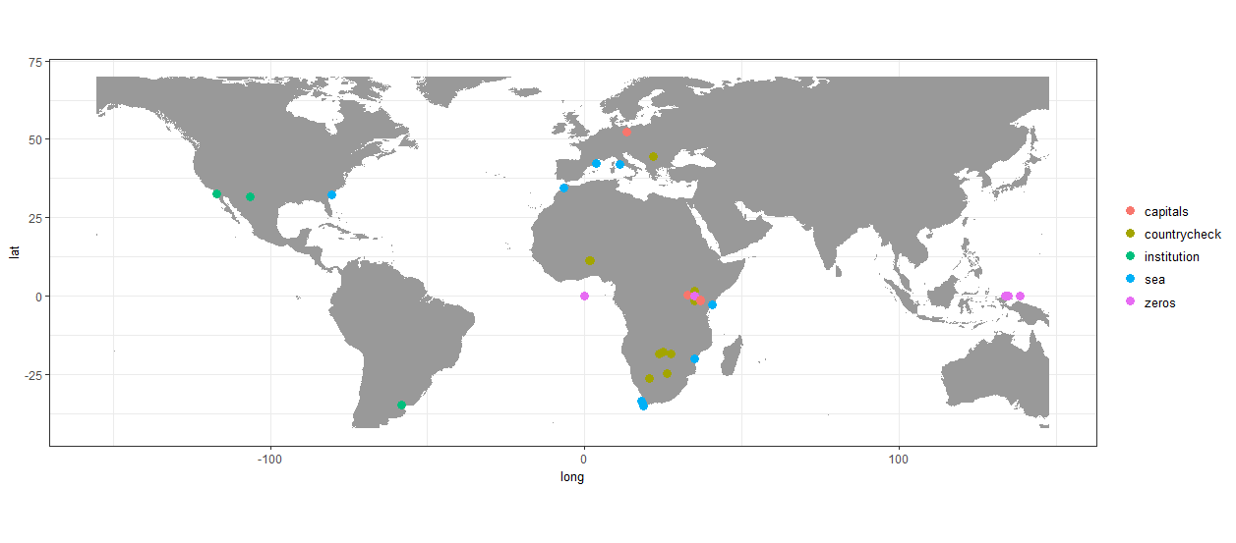
2. Data cleaning - Workflow

Slide 25
https://idiv-biodiversity.github.io/2019_big_data_biogeography/

Slide 26
3. Collection bias
Meyer et al (2015) Nat Comm

Slide 27
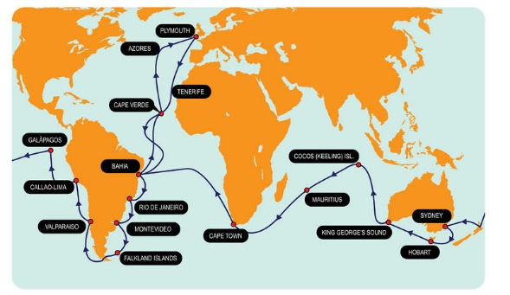
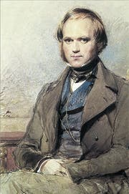
3. Bias - Geographic accessibility

Slide 28
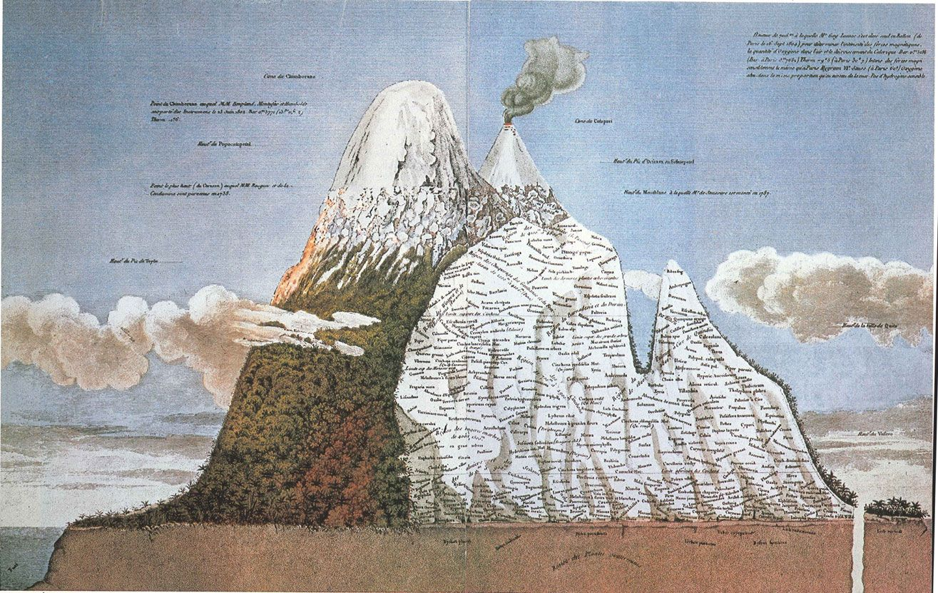
3. Bias - Geographic accessibility

Slide 29
3. Bias - Background

Slide 30
3. Bias - Background

Slide 31
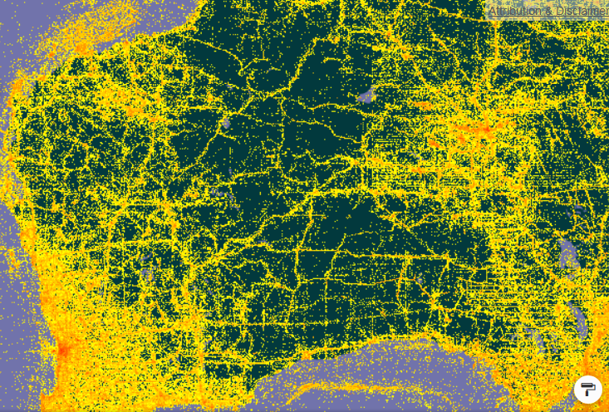
3. Bias - Background

Slide 32
Geographic accessibility
Notes:
Now that the problem of problematic coordinates ahs been addressed, we come to the next challenge of biological collection data, which is sampling biases. Sampling biases are inherent to virtually all biological collection datasets, and are mainly due to accessability. SO imagine again our south american plant genus. What we want is something like this, a more or less random sampling, where the occurrence correspond to the ecological niches of the species. What we most of the times have is something like this. That does not look to different on the first view

Slide 33
3. Bias - Background
Notes:
Now that the problem of problematic coordinates ahs been addressed, we come to the next challenge of biological collection data, which is sampling biases. Sampling biases are inherent to virtually all biological collection datasets, and are mainly due to accessability. SO imagine again our south american plant genus. What we want is something like this, a more or less random sampling, where the occurrence correspond to the ecological niches of the species. What we most of the times have is something like this. That does not look to different on the first view

Slide 34
3. Bias - Background
Roads
Notes:
Now that the problem of problematic coordinates ahs been addressed, we come to the next challenge of biological collection data, which is sampling biases. Sampling biases are inherent to virtually all biological collection datasets, and are mainly due to accessability. SO imagine again our south american plant genus. What we want is something like this, a more or less random sampling, where the occurrence correspond to the ecological niches of the species. What we most of the times have is something like this. That does not look to different on the first view

Slide 35
3. Bias - background
Roads
Cities
Notes:
Now that the problem of problematic coordinates ahs been addressed, we come to the next challenge of biological collection data, which is sampling biases. Sampling biases are inherent to virtually all biological collection datasets, and are mainly due to accessability. SO imagine again our south american plant genus. What we want is something like this, a more or less random sampling, where the occurrence correspond to the ecological niches of the species. What we most of the times have is something like this. That does not look to different on the first view

Slide 36
3. Bias - Background
Roads
Cities
Airports
Notes:
Now that the problem of problematic coordinates ahs been addressed, we come to the next challenge of biological collection data, which is sampling biases. Sampling biases are inherent to virtually all biological collection datasets, and are mainly due to accessability. SO imagine again our south american plant genus. What we want is something like this, a more or less random sampling, where the occurrence correspond to the ecological niches of the species. What we most of the times have is something like this. That does not look to different on the first view

Slide 37
3. Bias - Background
Roads
Cities
Airports
Rivers
Sampling increases with accessibility
Notes:
Now that the problem of problematic coordinates ahs been addressed, we come to the next challenge of biological collection data, which is sampling biases. Sampling biases are inherent to virtually all biological collection datasets, and are mainly due to accessability. SO imagine again our south american plant genus. What we want is something like this, a more or less random sampling, where the occurrence correspond to the ecological niches of the species. What we most of the times have is something like this. That does not look to different on the first view

Slide 38
Analysis pipeline
1. Download
2. Cleaning
3. Bias
Rgbif
PaleobioDB
4. Richness maps
Bonus - Automated conservation assessment
7. Biome classification
5. Bioregionalization
ConR

Slide 39
3. Sampling bias
Quantifying the relation between anthropogenic geographic features and occurrence records
Based on gazetteers and frequency distributions of distances

Slide 40
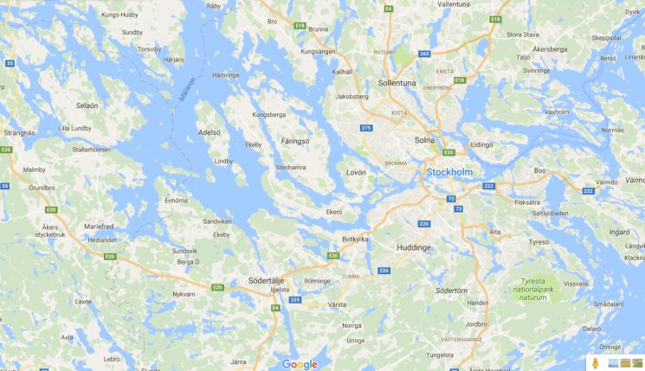
3. Bias - How does it work?
Gazetteer (e.g. streets)

Slide 41
3. Bias - How does it work?
Gazetteer (e.g. streets)

Slide 42
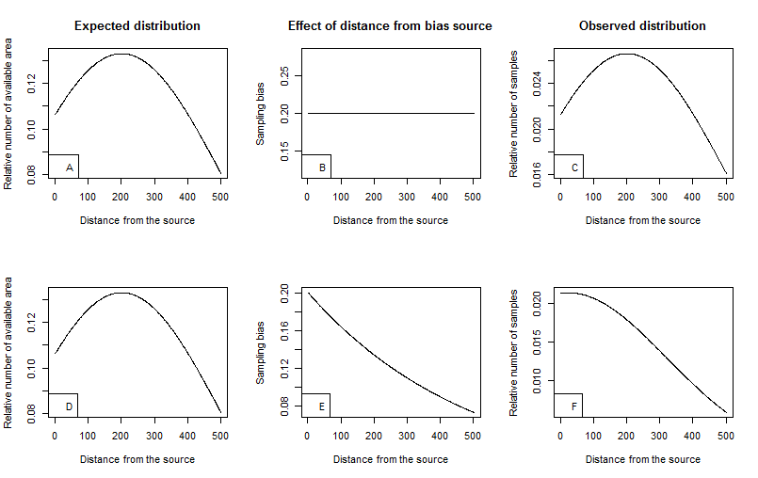
3. Bias - How does it work?
Gazetteer (e.g. streets)
Minimum distance
Expected distribution

Slide 43
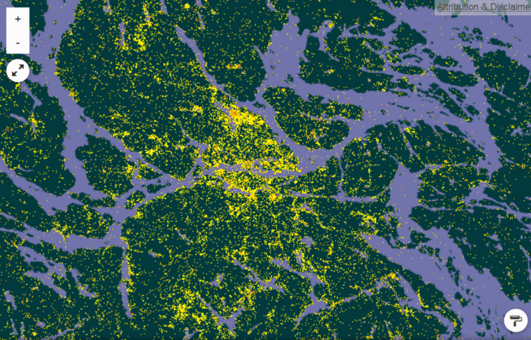
3. Bias - How does it work?
Gazetteer (e.g. streets)
Occurrences
Minimum distance
Expected distribution

Slide 44
3. Bias - How does it work?
Gazetteer (e.g. streets)
Occurrences
Minimum distance
Expected distribution
Observed distribution
Observed distribution

Slide 45
3. Bias - How does it work?

Slide 46
3. Bias – socio-economic factors
Daru et al. (2018), New Phytologist

Slide 47
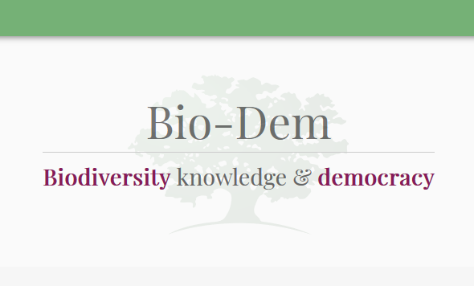
3. Bias – socio-economic factors
Explore the connection between political systems and biodiversity record collection
http://bio-dem.surge.sh/

Slide 48
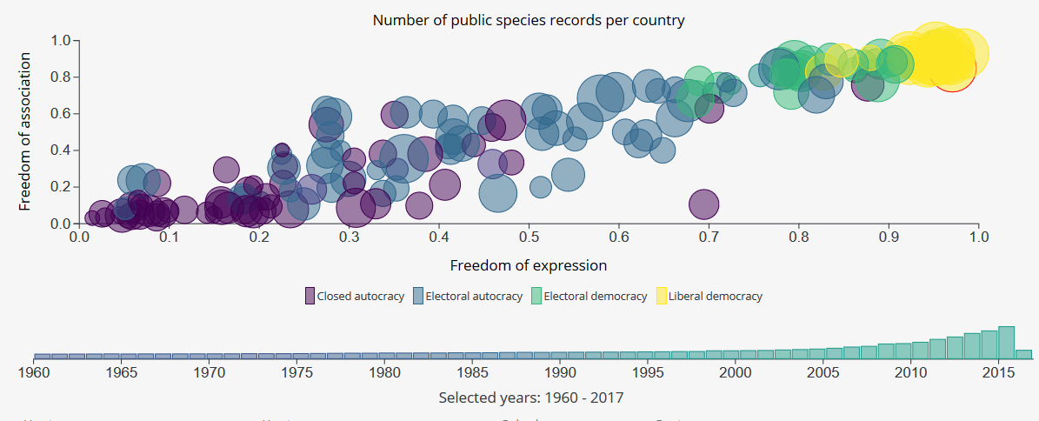
3. Bias – socio-economic factors

Slide 49
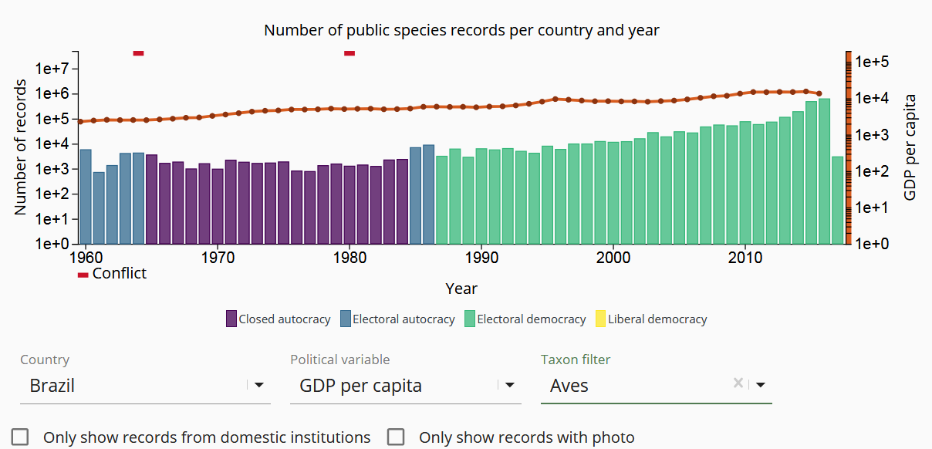
3. Bias - BioDem

Slide 50
Analysis pipeline
1. Download
2. Cleaning
3. Bias
Rgbif
PaleobioDB
Morning
4. Richness maps
Afternoon
Bonus - Automated conservation assessment
6. Biome classification
5. Bioregionalization
ConR

Slide 51
At the end of today
Make sure to have:
A cleaned set of species occurrences
Taxon specific bioregions for your study group
A classification of each of your species into these regions
A biome classification for all of your species
A phylogeny for your study group
Environmental data associated with all species records

Slide 52
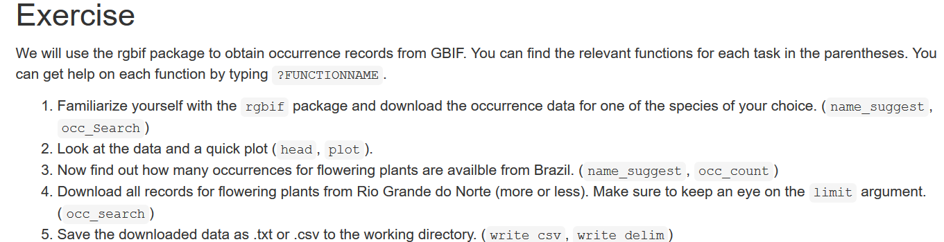
1. Downloading occurrences from GBIF

Slide 53
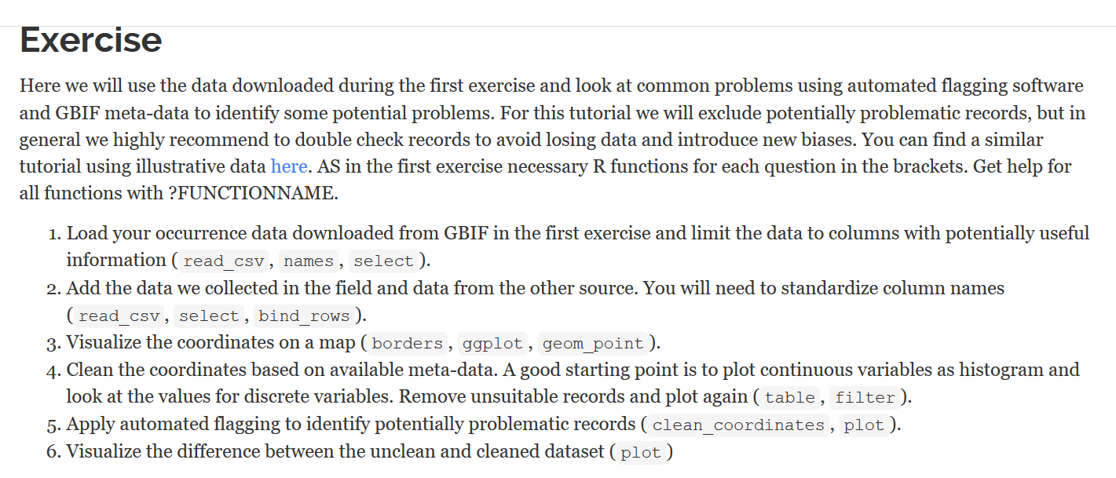
2. Cleaning distribution data

Slide 54
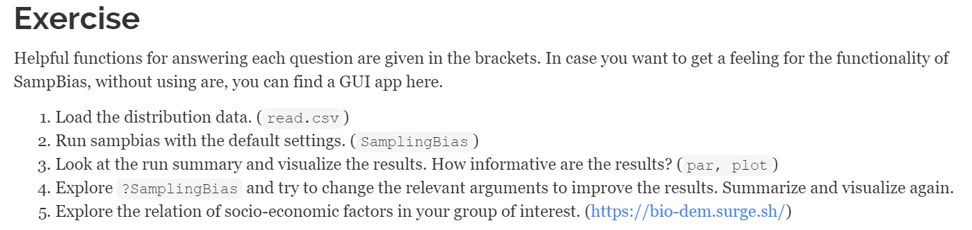
3. Exploring biases

Slide 55
Analysis pipeline
1. Download
2. Cleaning
3. Bias
Rgbif
PaleobioDB
Morning
4. Richness maps
Afternoon
Bonus - Automated conservation assessment
6. Biome classification
5. Bioregionalization
ConR

Slide 56
4. Specs ranges and richness maps
Töpel, Zizka et al. 2017 Syst Biol
Zizka et al. 2015 bioRxiv

Slide 57
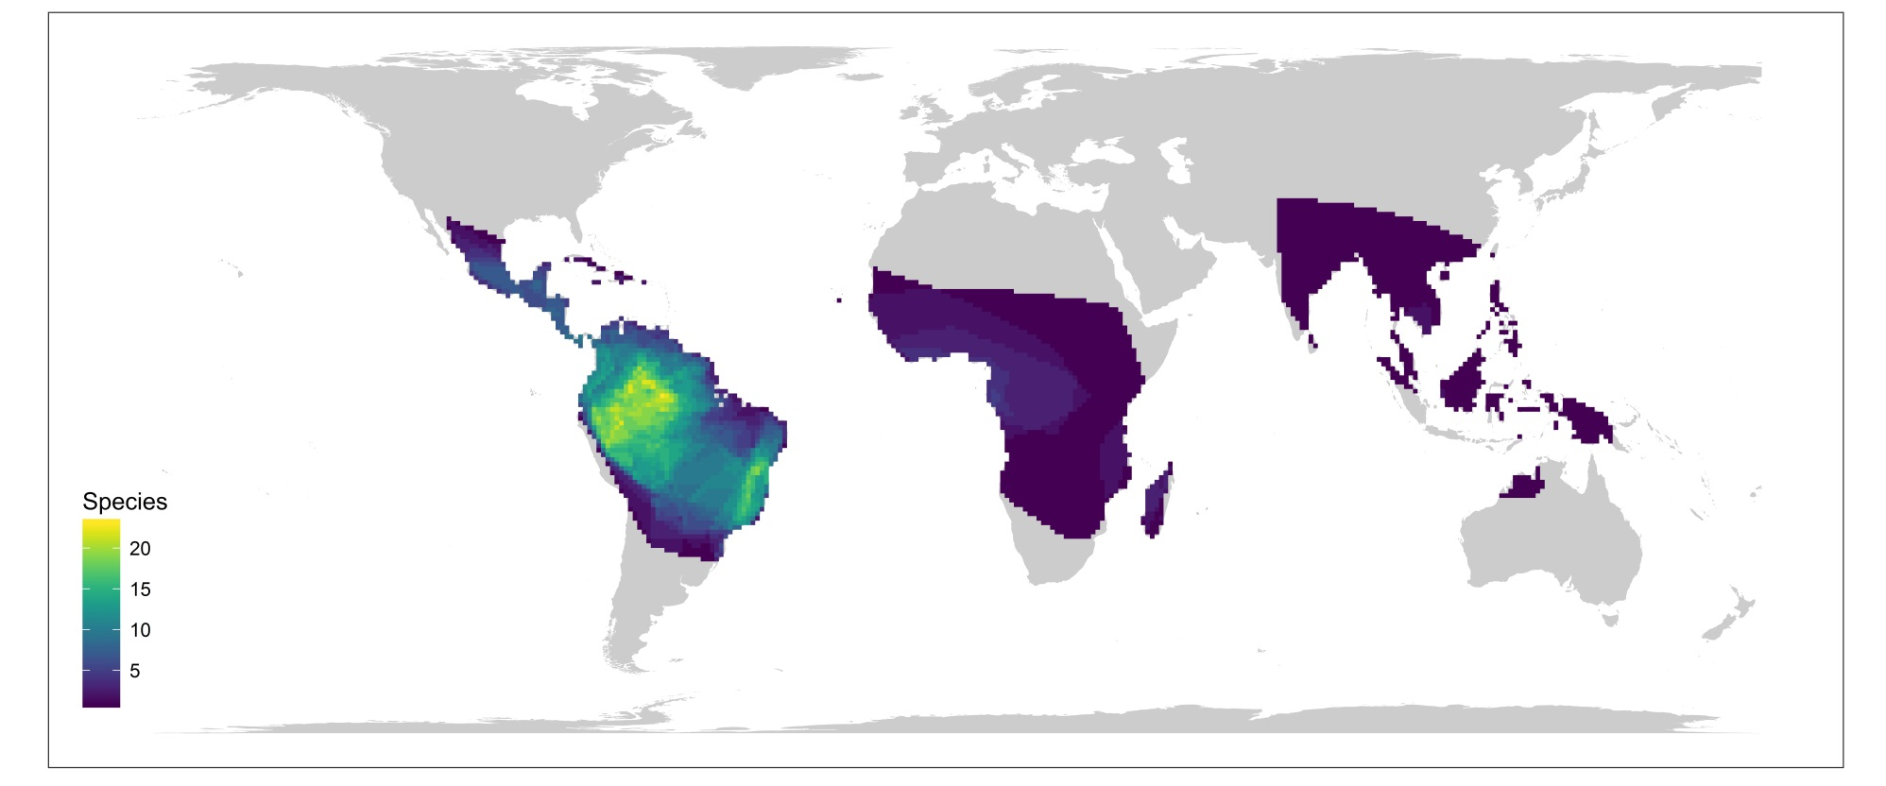
4. Species ranges & richness maps
Approximate species ranges
Visualize species richness patterns

Slide 58

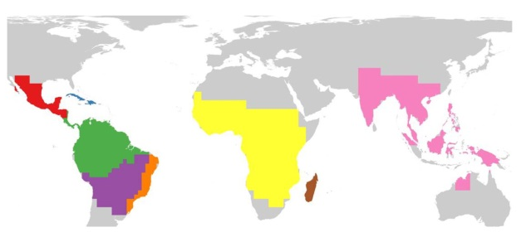
5. Bioregionalization

Slide 59
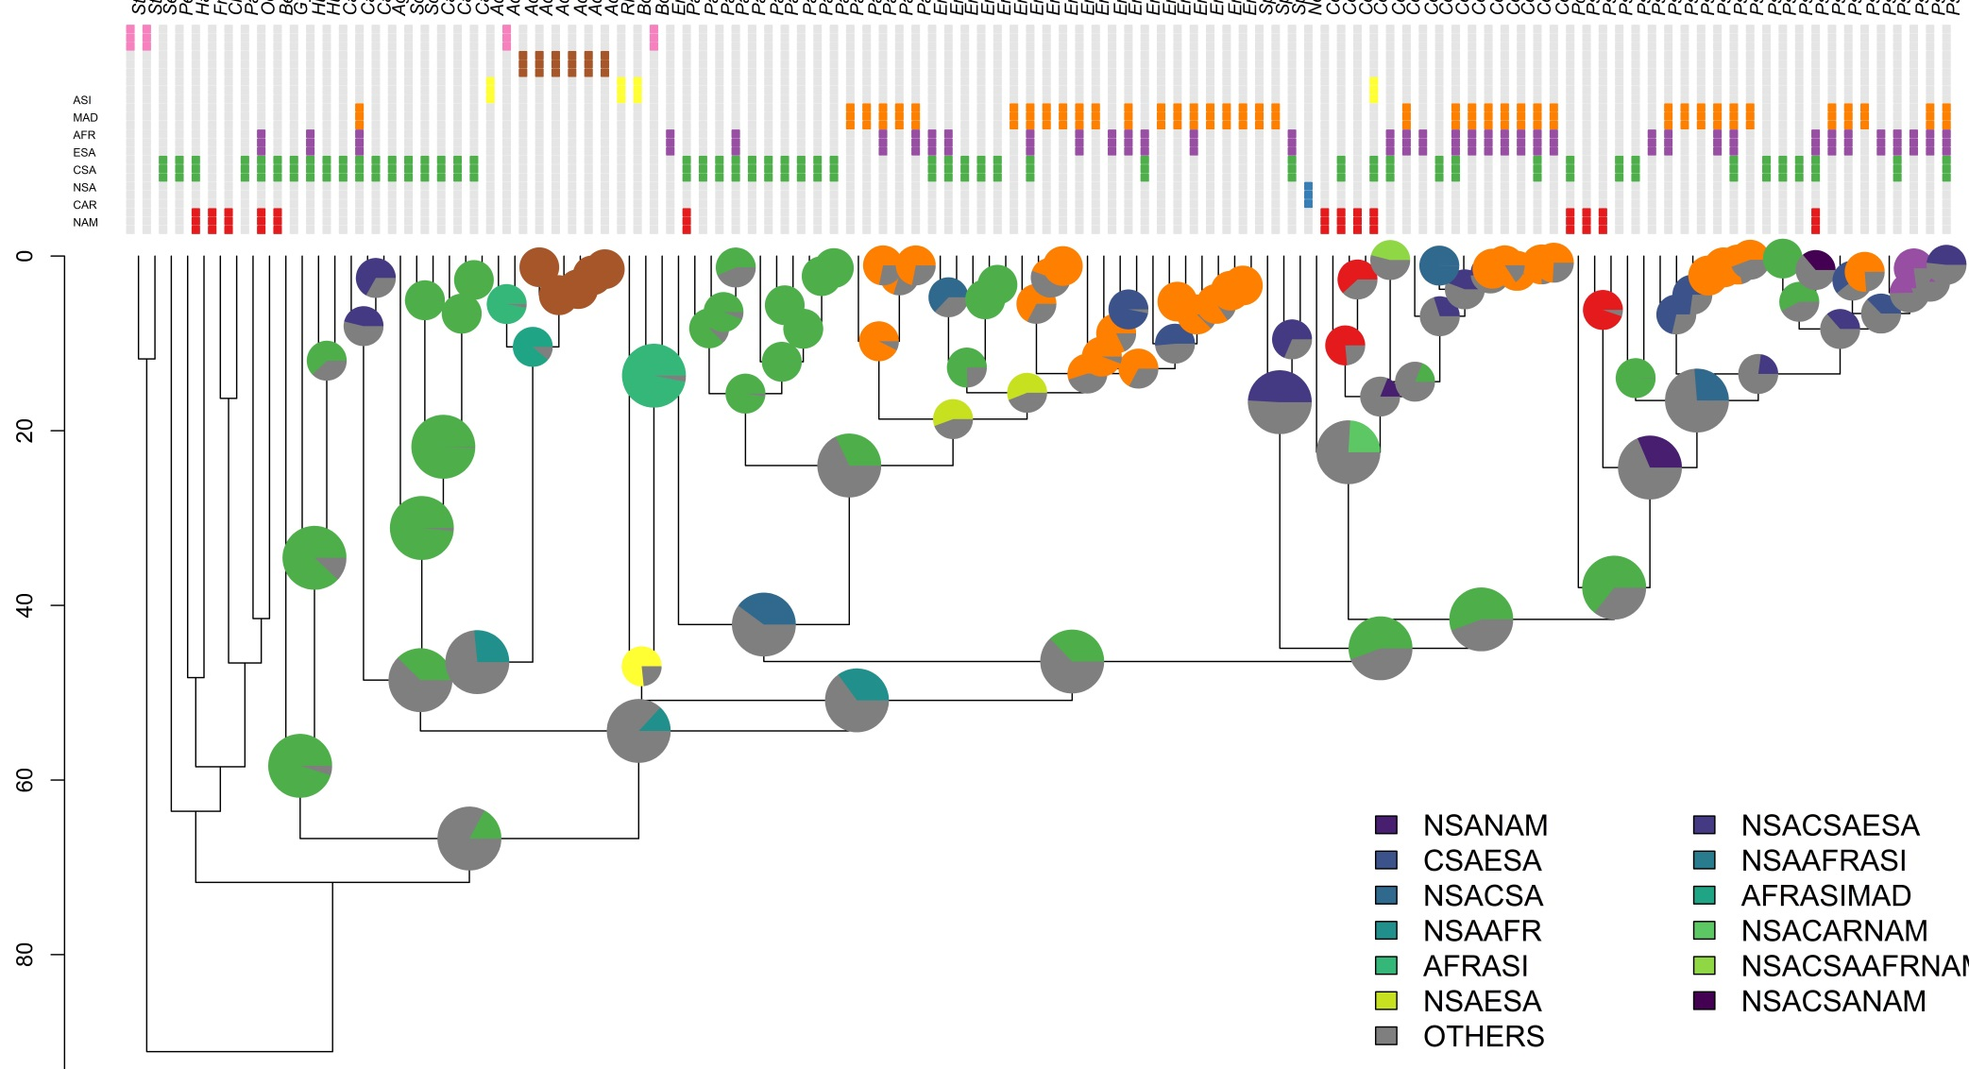
5. Bioregionalization
ASI
MAD
AFR
ESA
CSA
NSA
CAR
NAM

Slide 60
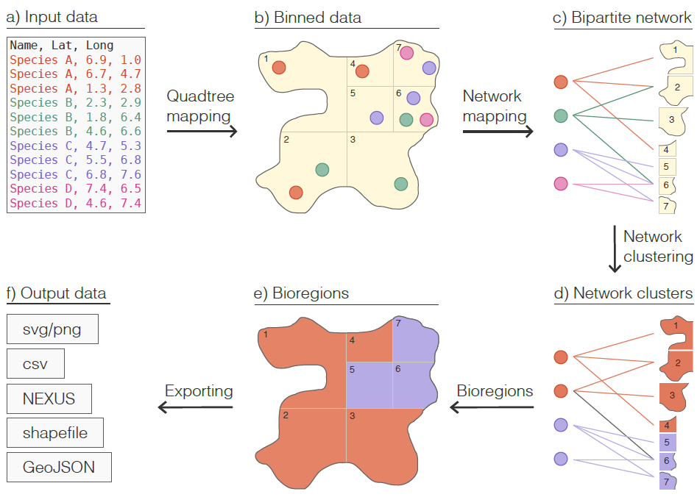

5. Bioregionalization - How does it work?

Slide 61
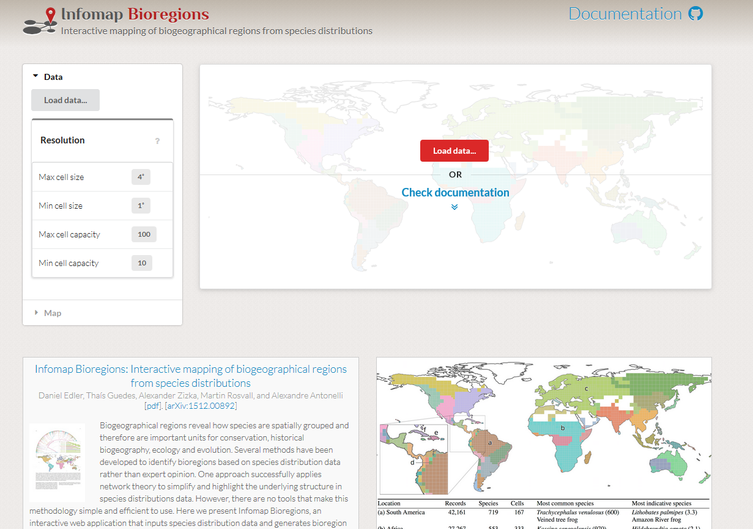
5. Bioregionalization - Workflow

Slide 62
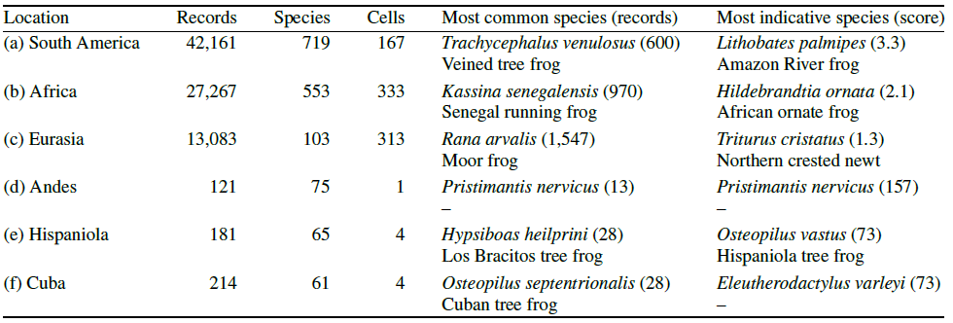
5. Bioregionalization - Output
Edler et al. 2017

Slide 63
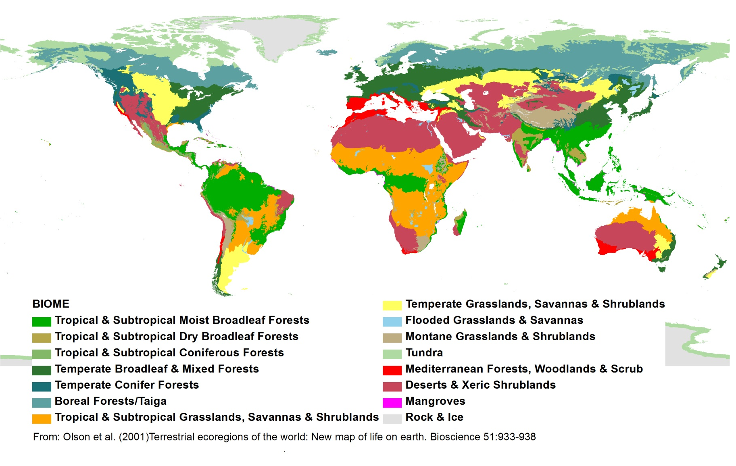
6. Biome classification

Slide 64
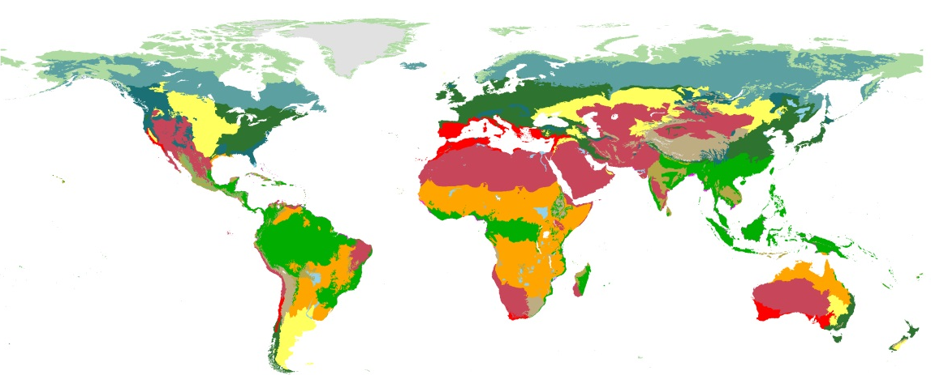
6. Biome classification
ASI
MAD
AFR
ESA
CSA
NSA
CAR
NAM

Slide 65
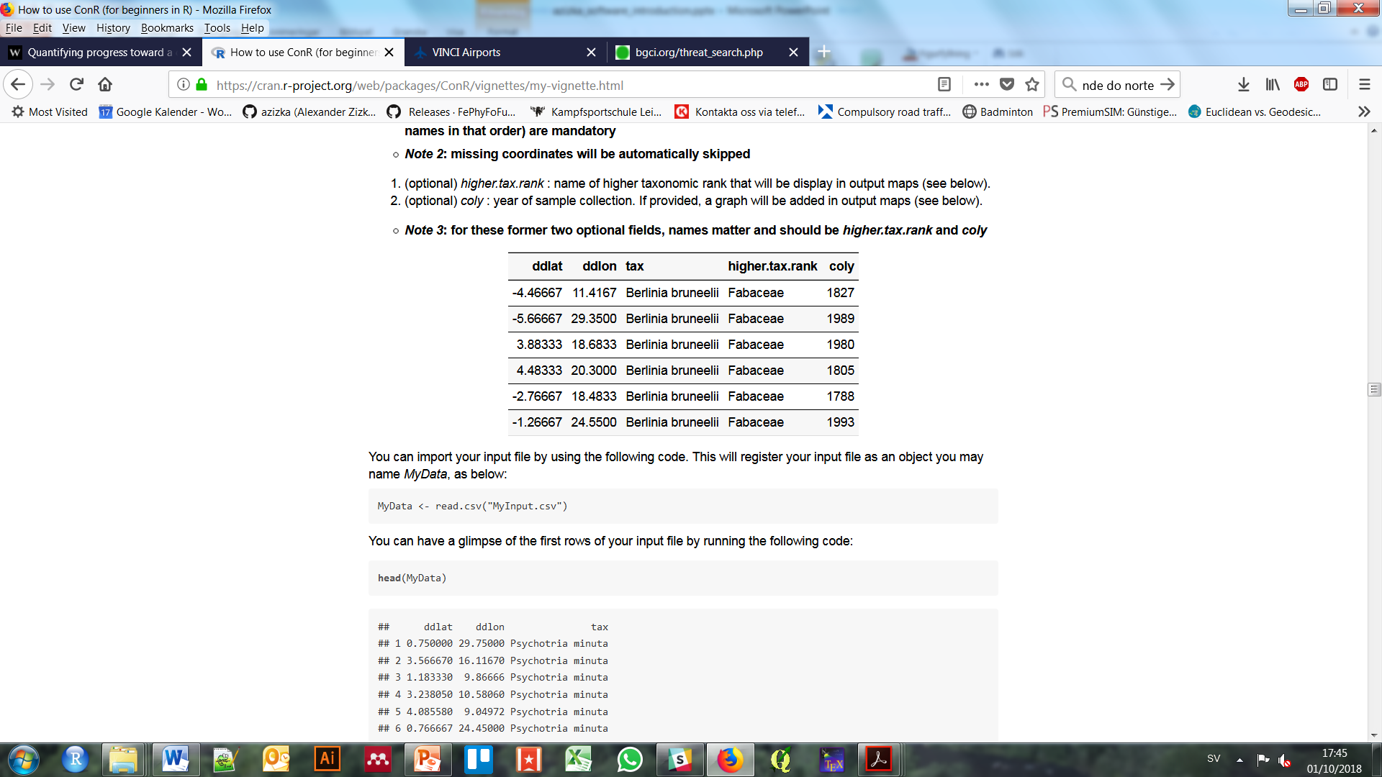
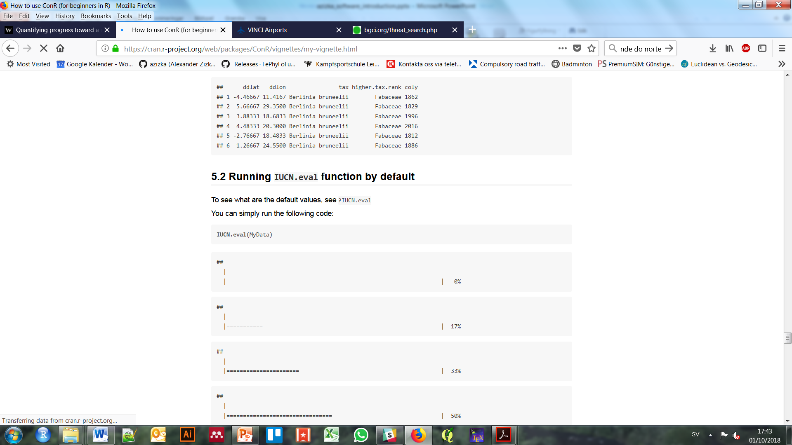
Bonus - Conservation assessment in ConR
ConR
Computation of Parameters Used in Preliminary Assessment of Conservation Status

Slide 66
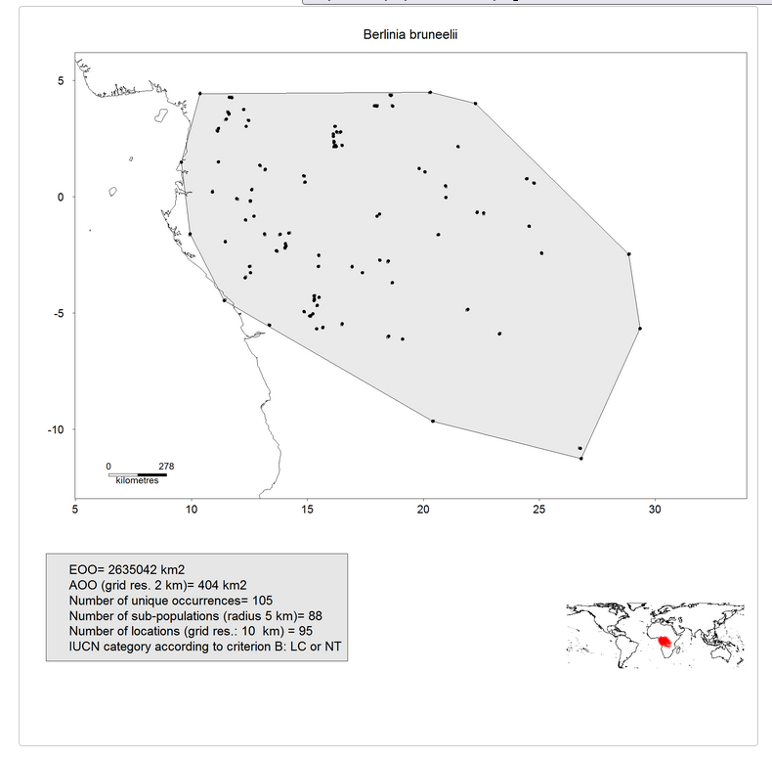
Bonus - Conservation assessment in ConR
ConR

Slide 67
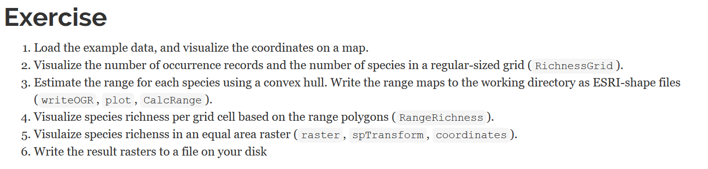
4. Species ranges & richness maps

Slide 68
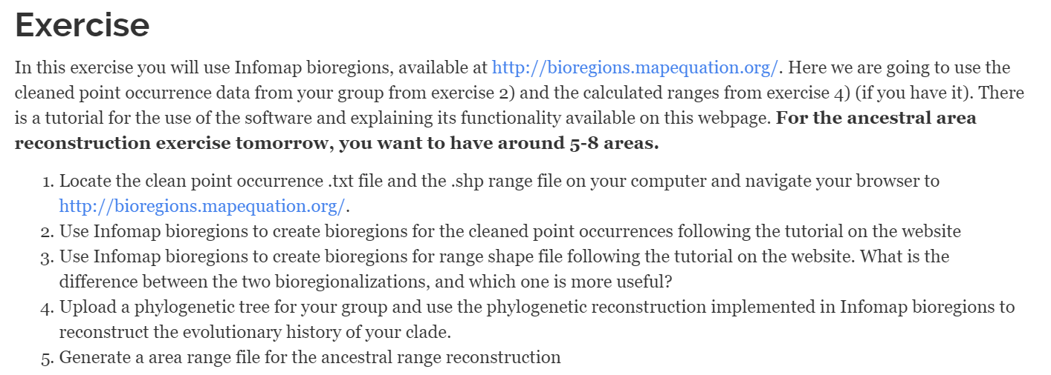
5. Taxon-specific bioregionalization

Slide 69
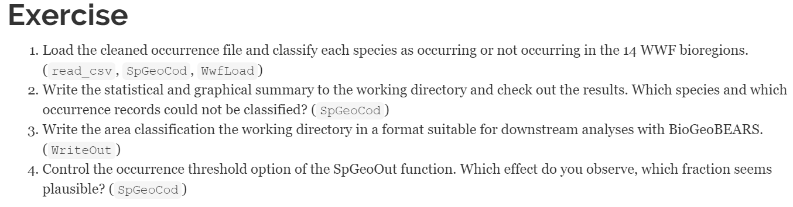
6. Species to biome classification

Slide 70
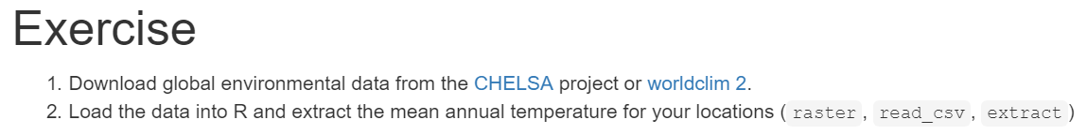
7. Obtaining environmental data

Slide 71
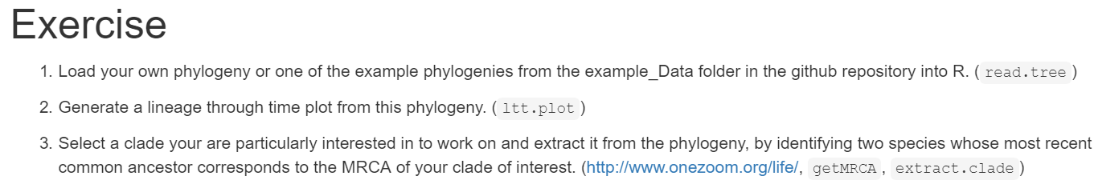
8. Extracting clades from a phylogeny

Slide 72
Bonus – Conservation assessment

Slide 73
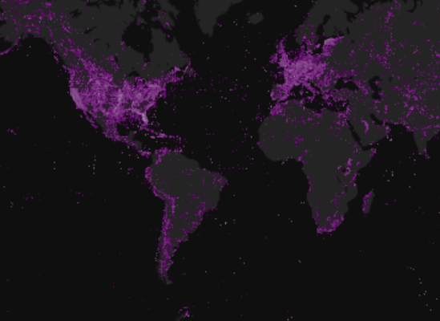
Danke!
ConR
Rgbif
https://github.com/azizka/CoordinateCleaner
https://github.com/azizka/sampbias
Notes:
SO if you are working with coordinates and biological collections check out samp bias and Species geocoder. Speciesgeocoder is availble from CRAN or the webpage of the Antonelli lab, and sampbias is available as beta version from Github and will be released in February. If you have questions, please do not hesitaed to drop me a line. Muchas Gracias!

